Slide 1
AZ-104T00A Administer Virtual Networking

Slide 2
Administer Virtual Networking Introduction
Configure Virtual Networks
Configure Network Security Groups
Configure Azure DNS
Lab 04 – Implement Virtual Networks
Notes:
Module overview

Slide 3
Administer Virtual Networking whiteboard and review
Connectivity
On-premises
Other virtual networks
Endpoints
Service
Private
Naming guidelines
virtual networks
Traffic routing
NSGs
ASGs
Azure Firewall
Subnets
DNS
zones
custom names
IP addressing
public
private
Notes:
Optional whiteboard slide to introduce the module or review the content. Use the whiteboard diagram directly or recreate the image during the class.
What is a virtual network and what things should you consider when creating a virtual network?
Answer: A virtual network is a logical representation of your own network. Virtual networks can be used in cloud and hybrid cloud scenarios. When creating a virtual network, you will need to define the address space and create at least one subnet. Subnets in the virtual network subnet must have a unique address range that does not overlap with other subnets. Also consider traffic control, resource isolation, and topology.
What are the two types of virtual networking addresses and how are the addresses used?
Answer: Private IP addresses used within an Azure virtual network, and the on-premises network. When you use a VPN gateway or ExpressRoute circuit to extend your network to Azure, you are using private IP addresses. Public IP addresses are used for communication with the internet, including Azure public-facing services. For example, a customer retail website.
What is a Network Security Group (NSG) and when would you use it?
Answer: A NSG filters network traffic to and from Azure resources in an Azure virtual network. An NSG lists the security rules that allow or deny inbound or outbound network traffic. For example, limiting inbound traffic to only frontend web servers. Another example, limiting outbound traffic from internal virtual machines.
What is an Application Security Group (ASG) and when would you use it?
Answer: An ASG is a logical grouping of virtual machines. For example, you could group web servers and SQL database application servers. To control the traffic flow security rules can then be assigned to each ASG. By placing a NSG around the ASGs you can further control inbound and outbound access.
What is an Azure Firewall and how would you use it?
Answer: Azure Firewall is a managed, cloud-based network security service that protects your Azure virtual network resources. Firewalls are usually deployed in a hub-spoke topology. Shared services (i.e., Bastion, VPN Gateways) are in the hub. Internal services are isolated and protected in the spokes. Azure Firewall can be used to translate and filter inbound internet traffic to your subnets. Azure Firewall can also be used to connect your on-premises network to Azure. You can configure rules (source addresses, protocols, destination ports, and destination addresses) to specific exactly what the firewall filters.
What is an Azure DNS domain, and can you change the name assigned to you?
Answer:. The domain name system (DNS) is a naming database in which internet domain names are located and translated into Internet Protocol (IP) addresses. The domain name system maps the name people use to locate a website to the IP address that a computer uses to locate that website. Azure DNS is a hosting service for DNS domains that provides name resolution. When you create an Azure subscription an Azure AD domain is created for you. This initial domain takes the form domainname.onmicrosoft.com. You can change or customize the domain name. However, you will need to verify ownership of the domain name.

Slide 4
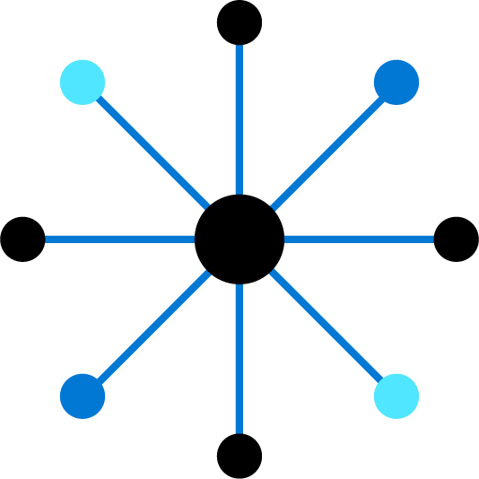
Configure Virtual Networks

Slide 5
Configure Virtual Networks Introduction
Plan Virtual Networks
Create Virtual Networks
Create Subnets
Plan IP Addressing
Create Public IP Addresses
Associate Public IP Addresses
Allocate or Assign Private IP Addresses
Demonstration – Virtual Networks
Summary and Resources
Notes:
Implement and manage virtual networking (15–20%)
Configure and manage virtual networks in Azure
Create and configure virtual networks and subnets
Configure public IP addresses

Slide 6
Plan Virtual Networks
Virtual Network
Subnet
On-premises
NIC
NIC
Virtual Network(s)
Virtual Machines
Logical representation of your own network
Create a dedicated private cloud-only virtual network
Securely extend your datacenter with virtual networks
Enable hybrid cloud scenarios
Notes:
Azure Virtual Networks - https://azure.microsoft.com/services/virtual-network/
What is Azure Virtual Network? - https://docs.microsoft.com/azure/virtual-network/virtual-networks-overview

Slide 7
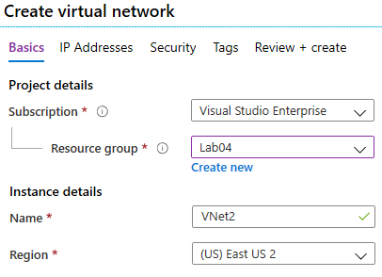
Create Virtual Networks
Create new virtual networks at any time
Add virtual networks when you create a virtual machine
Need to define the address space, and at least one subnet
Be careful with overlapping address spaces
Notes:
QuickStart: Create a virtual network using the Azure portal - https://docs.microsoft.com/azure/virtual-network/quick-create-portal
✔️ Always plan to use an address space that is not already in use in your organization, either on-premises or in other VNets. Even if you plan for a VNet to be cloud-only, you may want to make a VPN connection to it later. If there is any overlap in address spaces at that point, you will have to reconfigure or recreate the VNet. The next lesson will focus on IP addressing.

Slide 8
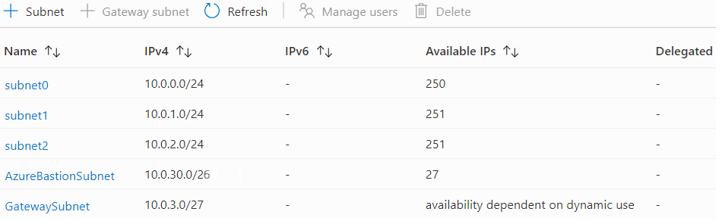
Create Subnets
A virtual network can be segmented into one or more subnets
Subnets provide logical divisions within your network
Subnets can help improve security, increase performance, and make it easier to manage the network
Each subnet must have a unique address range – cannot overlap with other subnets in the vnet in the subscription
Notes:
✔️ Azure reserves 5 IP addresses within each subnet.
x.x.x.0: Network address
x.x.x.1: Reserved by Azure for the default gateway
x.x.x.2, x.x.x.3: Reserved by Azure to map the Azure DNS IPs to the VNet space
x.x.x.255: Network broadcast address

Slide 9
Plan IP Addressing
Azure
Resource
Internet, public-facing services
VNets, on-premises networks, VPN gateways, ExpressRoute
Private IP address
Public IP address
Private IP addresses - used within an Azure virtual network (VNet), and your on-premises network, when you use a VPN gateway or ExpressRoute circuit to extend your network to Azure
Public IP addresses - used for communication with the Internet, including Azure public-facing services
Notes:
Design an IP addressing schema for your Azure deployment – https://docs.microsoft.com/learn/modules/design-ip-addressing-for-azure
✔️ As a best practice you may decide to separate dynamically and statically assigned IP resources into different subnets. And, IP Addresses are never managed from within a virtual machine.

Slide 10
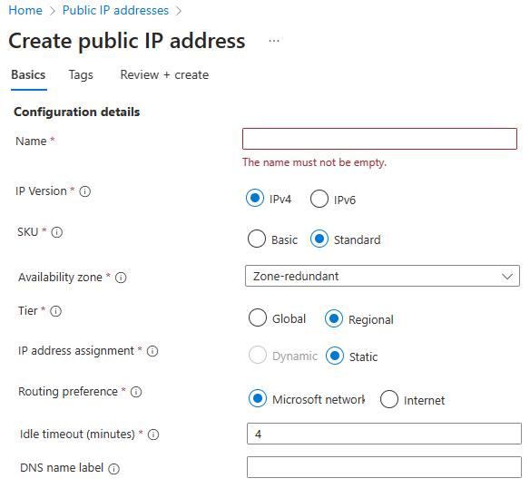
Create Public IP Addresses
Available in IPv4 or IPv6 or both
Basic vs Standard SKU
Dynamic vs Static
Microsoft vs. internet routing
Notes:
Create, change, or delete IP addresses - https://docs.microsoft.com/azure/virtual-network/virtual-network-public-ip-address

Slide 11
Associate Public IP Addresses
Public IP addresses | IP address association | Dynamic | Static
Virtual Machine | NIC | Yes | Yes
Load Balancer | Front-end configuration | Yes | Yes
VPN Gateway | Gateway IP configuration | Yes | Yes*
Application Gateway | Front-end configuration | Yes | Yes*
A public IP address resource can be associated with virtual machine network interfaces, internet-facing load balancers, VPN gateways, and application gateways
*Static IP addresses only available on certain SKUs.
Notes:
Public IP addresses - https://docs.microsoft.com/azure/virtual-network/public-ip-addresses

Slide 12
Allocate or Assign Private IP Addresses
Private IP Addresses | IP address association | Dynamic | Static
Virtual Machine | NIC | Yes | Yes
Internal Load Balancer | Front-end configuration | Yes | Yes
Application Gateway | Front-end configuration | Yes | Yes
Dynamic (default). Azure assigns the next available unassigned or unreserved IP address in the subnet’s address range
Static. You select and assign any unassigned or unreserved IP address in the subnet's address range
Notes:
Private IP addresses - https://docs.microsoft.com/azure/virtual-network/private-ip-addresses

Slide 13
Demonstration – Virtual Networks
Create a virtual network in the portal
Create a virtual network with PowerShell
Notes:
Quickstart: Create a virtual network - Azure portal - https://docs.microsoft.com/azure/virtual-network/quick-create-portal

Slide 14
Summary and Resources – Configure Virtual Networks
Knowledge Check
Microsoft Learn Modules (docs.microsoft.com/Learn)
Design an IP addressing schema for your Azure deployment (Sandbox)
Implement Windows Server IaaS VM IP addressing and routing
Introduction to Azure Virtual Networks
A sandbox indicates a hands-on exercise.
Notes:
Learn - https://docs.microsoft.com/learn/browse/
The Assessment Guide in the MCT DLC has open-ended questions.
What is a virtual network and what things should you consider when creating a virtual network?
Answer: A virtual network is a logical representation of your own network. Virtual networks can be used in cloud and hybrid cloud scenarios. When creating a virtual network, you will need to define the address space and create at least one subnet. Subnets in the virtual network subnet must have a unique address range that does not overlap with other subnets. Also consider traffic control, resource isolation, and topology.
What are the two types of virtual networking addresses and how are the addresses used?
Answer: Private IP addresses used within an Azure virtual network, and your on-premises network. When you use a VPN gateway or ExpressRoute circuit to extend your network to Azure, you are using private IP addresses. Public IP addresses are used for communication with the internet, including Azure public-facing services. For example, a customer retail website.

Slide 15
Configure Network Security Groups

Slide 16



Configure Network Security Groups Introduction
Implement Network Security Groups (NSGs)
Determine NSG Rules
Determine NSG Effective Rules
Create NSG Rules
Implement Application Security Groups (ASGs)
Demonstration – NSGs
Summary and Resources
Notes:
Implement and manage virtual networking (15–20%)
Configure secure access to virtual networks
Create and configure network security groups (NSGs) and application security groups
Evaluate effective security rules in NSGs

Slide 17
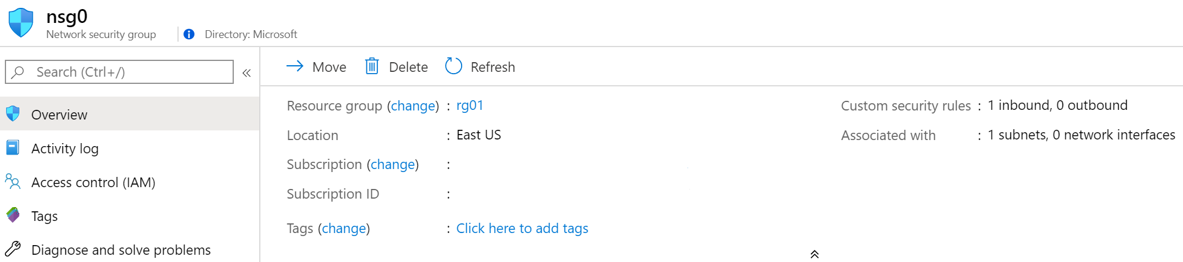
Implement Network Security Groups (NSGs)
Limits network traffic to resources in a virtual network
Lists the security rules that allow or deny inbound or outbound network traffic
Associated to a subnet or a network interface
Can be associated multiple times
Notes:
Network Security Groups - https://docs.microsoft.com/azure/virtual-network/security-overview#network-security-groups
✔️ To simplify management of security rules, it's recommended that you associate a network security group to individual subnets, rather than individual network interfaces within the subnet.

Slide 18
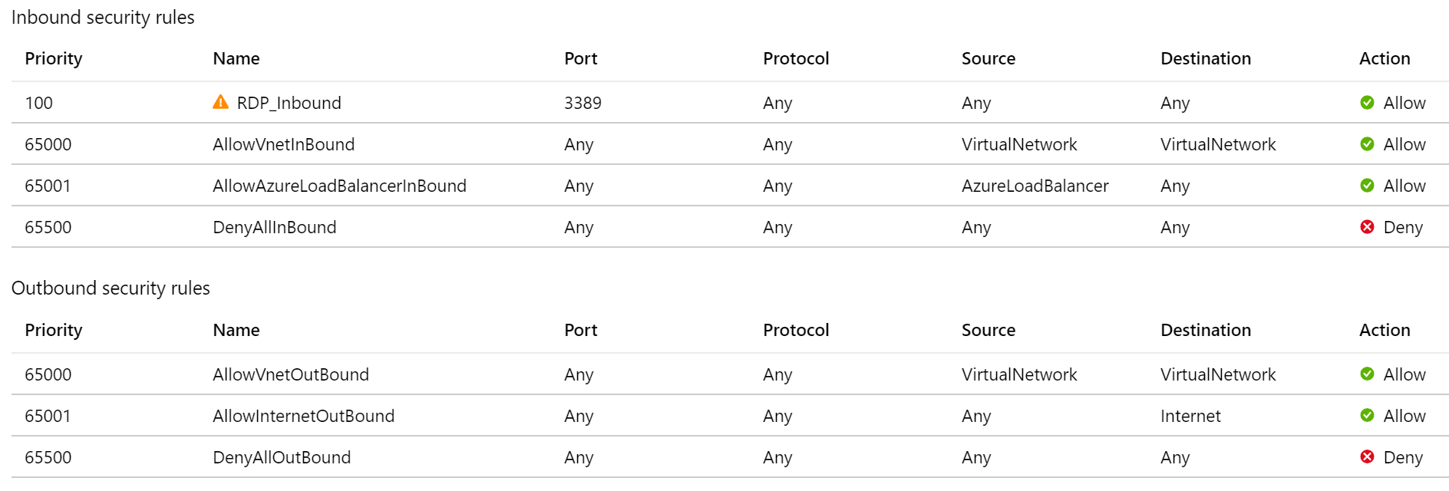
Determine NSG Rules
Security rules in NSGs enable you to filter network traffic that can flow in and out of virtual network subnets and network interfaces
There are default security rules. You cannot delete the default rules, but you can add other rules with a higher priority
Notes:
Create, change, or delete a network security group -https://docs.microsoft.com/azure/virtual-network/manage-network-security-group

Slide 19
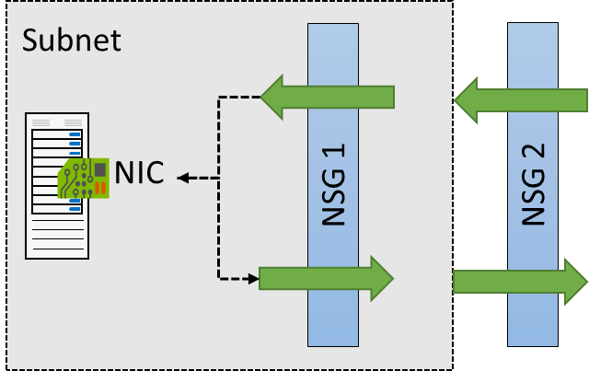
Determine NSG Effective Rules
NSGs are evaluated independently for the subnet and NIC
An “allow” rule must exist at both levels for traffic to be admitted
Use the Effective Rules link if you are not sure which security rules are being applied

Slide 20
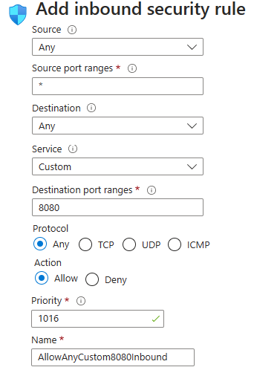
Create NSG rules
Source (Any, IP addresses, My IP address, service tags, and application security group)
Destination (Any, IP addresses, service tag, and application security group)
Service (HTTPS, SSH, RDP, DNS, POP3, custom, …)
Priority – The lower the number, the higher the priority
Notes:
Tutorial: Filter network traffic with a network security group using the Azure portal - https://docs.microsoft.com/azure/virtual-network/tutorial-filter-network-traffic
Secure and isolate access to Azure resources by using network security groups and service endpoints - https://docs.microsoft.com/learn/modules/secure-and-isolate-with-nsg-and-service-endpoints/

Slide 21



Implement Application Security Groups
Extends your application's structure
ASGs logically group virtual machines – web servers, application servers
WebServers
AppLServers
Define rules to control the traffic flow
Wrap the ASG with an NSG for added security
Source | Destination | Port
Internet | WebServers | 80, 443
WebServers | SQLServers | 1433
Notes:
There is no associated student material.
Application Security Groups - https://docs.microsoft.com/azure/virtual-network/application-security-groups

Slide 22
Demonstration – Network Security Groups
Access the NSGs blade
Add a new NSG
Explore inbound and outbound rules
Notes:
Restrict access to PaaS resources - tutorial - Azure portal - https://docs.microsoft.com/azure/virtual-network/tutorial-restrict-network-access-to-resources

Slide 23
Summary and Resources – Configure Network Security Groups
Knowledge Check
Microsoft Learn Modules (docs.microsoft.com/Learn)
Secure and isolate access to Azure resources by using network security groups and service endpoints (Sandbox)
A sandbox indicates a hands-on exercise.
Notes:
Learn - https://docs.microsoft.com/learn/browse/
The Assessment Guide in the MCT DLC has open-ended questions.
What is a Network Security Group (NSG) and when would you use it?
Answer: A NSG filters network traffic to and from Azure resources in an Azure virtual network. An NSG lists the security rules that allow or deny inbound or outbound network traffic. For example, limiting inbound traffic to only frontend web servers. Another example, limiting outbound traffic from protect internal virtual machines.
What is an Application Security Group (ASG) and when would you use it?
Answer: An ASG is a logical grouping of virtual machines. For example, you could group web servers and SQL database application servers. To control the traffic flow security rules can then be assigned to each ASG. By placing a NSG around the ASGs you can further control inbound and outbound access.

Slide 24
Configure Azure DNS

Slide 25
Configure Azure DNS Introduction
Identify Domains and Custom Domains
Verify Custom Domain Names (optional)
Create Azure DNS Zones
Delegate DNS Domains
Add DNS Record Sets
Plan for Private DNS Zones
Determine Private Zone Scenarios (optional)
Demonstration – DNS Name Resolution
Summary and Resources
Notes:
Implement and manage virtual networking (15–20%)
Configure name resolution and load balancing
Configure Azure DNS

Slide 26
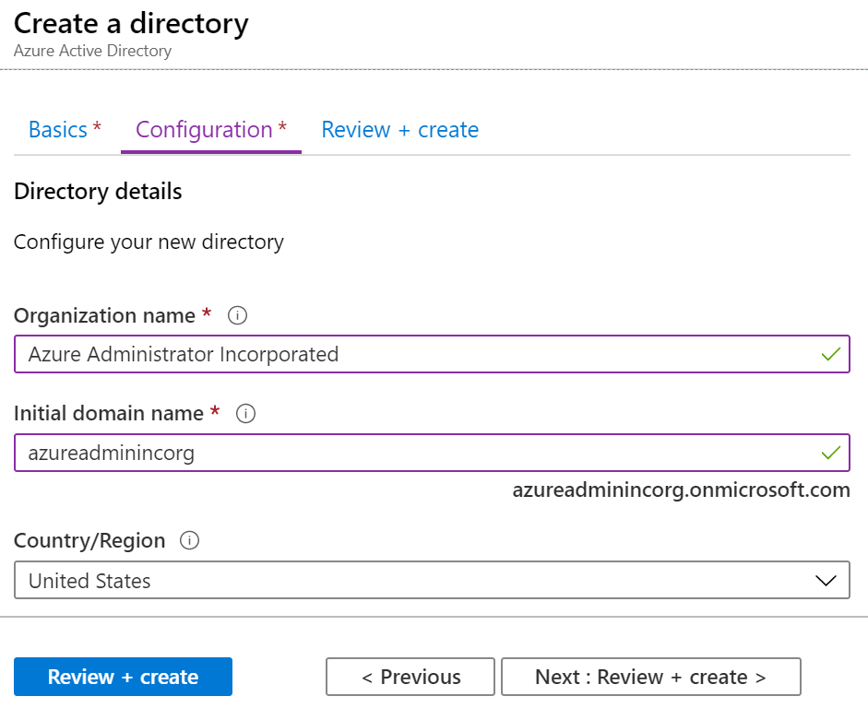
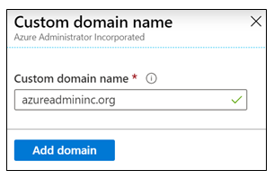
Identity Domains and Custom Domains
When you create a new subscription, a new Azure AD domain default domain is created
The domain has initial domain name in the form domainname.onmicrosoft.com
You can customize/change the name
After the custom name is added it must be verified – this demonstrates ownership of the domain
Notes:
What is Azure DNS? - https://docs.microsoft.com/azure/dns/dns-overview

Slide 27
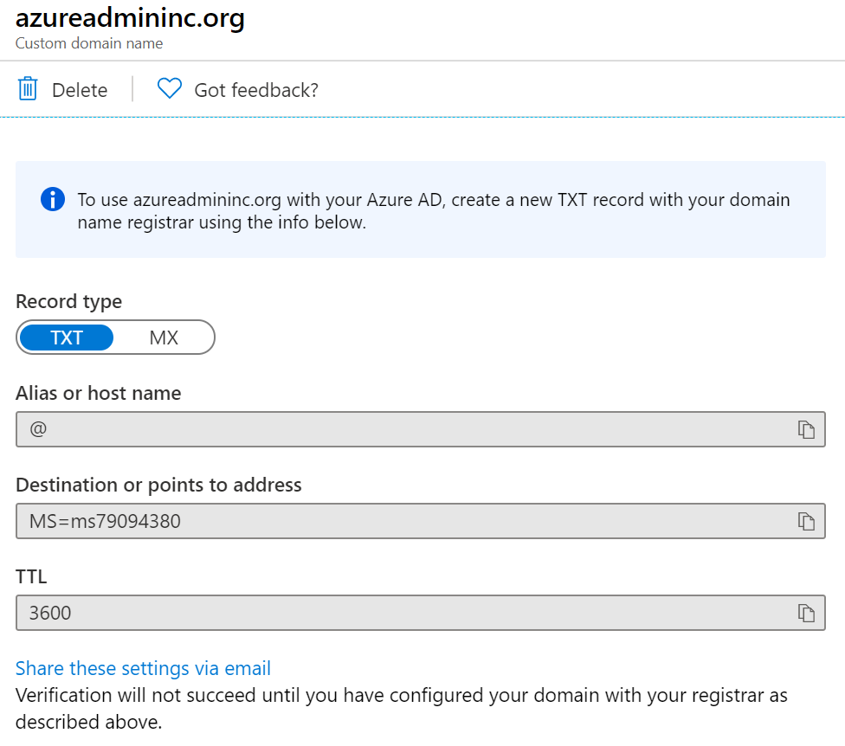
Verify Custom Domain Names
Verification demonstrates ownership of the domain name
Add a DNS record (MX or TXT) that is provided by Azure into your company’s DNS zone
Azure will query the DNS domain for the presence of the record
This could take several minutes or several hours
Notes:
QuickStart: Create an Azure DNS zone and record using the Azure portal - https://docs.microsoft.com/azure/dns/dns-getstarted-portal

Slide 28
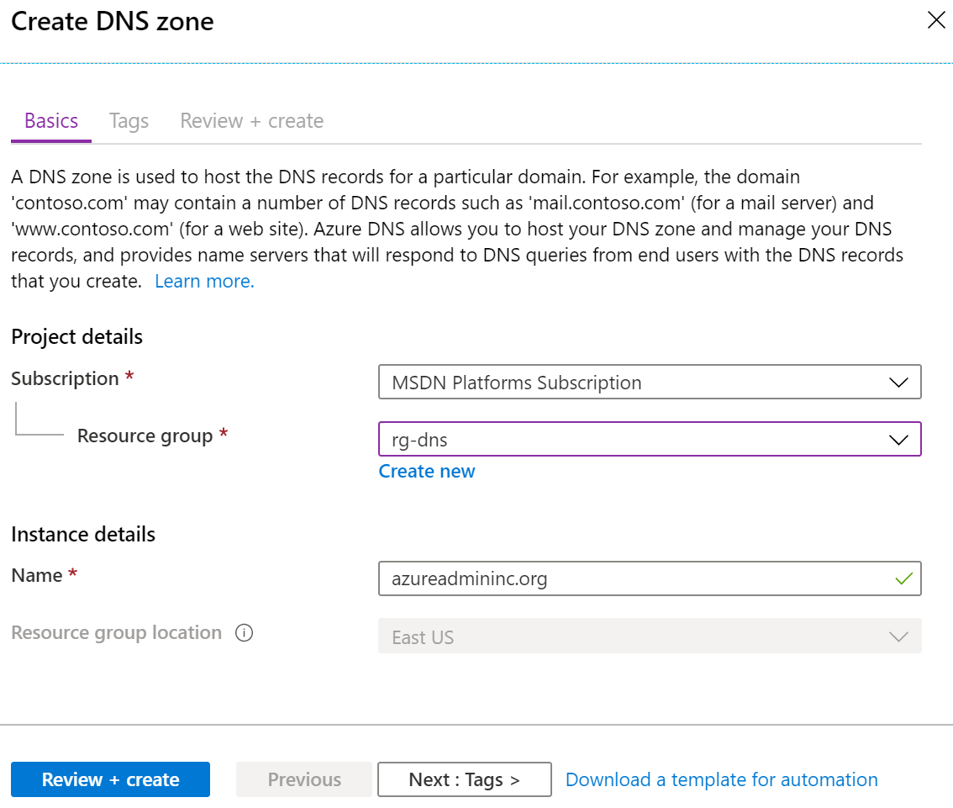
Create Azure DNS Zones
A DNS zone hosts the DNS records for a domain
Where multiple zones share the same name, each instance is assigned different name server addresses
Root/Parent domain is registered at the registrar and pointed to Azure NS
Notes:
DNS Zones - https://docs.microsoft.com/azure/dns/dns-zones-records#dns-zones
✔️ You do not have to own a domain name to create a DNS zone with that domain name in Azure DNS. However, you do need to own the domain to configure the domain.

Slide 29
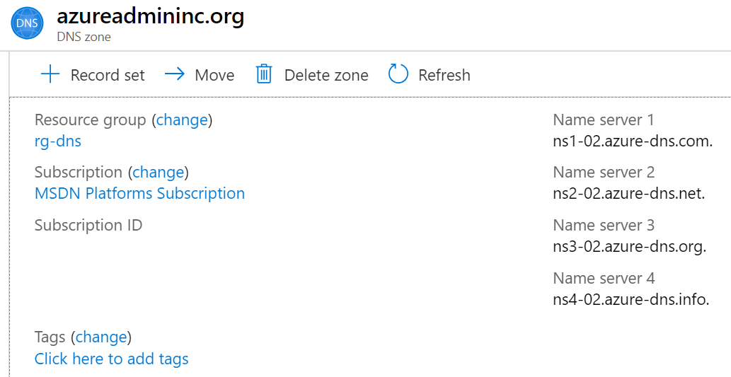
Delegate DNS Domains
When delegating a domain to Azure DNS, you must use the name server names provided by Azure DNS – use all four
Once the DNS zone is created, update the parent registrar
For child zones, register the NS records in the parent domain
Notes:
Host your domain on Azure DNS - https://docs.microsoft.com/learn/modules/host-domain-azure-dns/

Slide 30
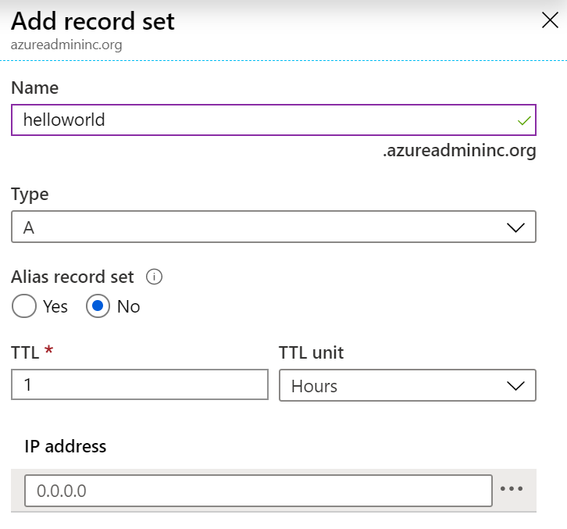
Add DNS Record Sets
A record set is a collection of records in a zone that have the same name and are the same type
You can add up to 20 records to any record set
A record set cannot contain two identical records
Changing the drop-down Type, changes the information required

Slide 31
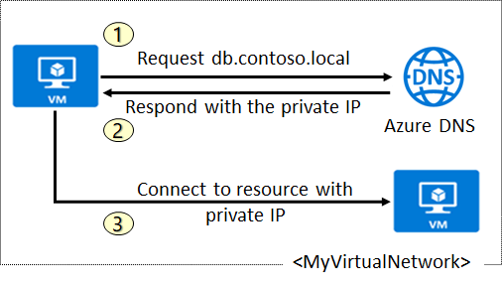
Plan for Private DNS Zones
Use your own custom domain names
Provides name resolution for VMs within a VNet and between VNets
db.contoso.lab
Automatic hostname record management
Removes the need for custom DNS solutions
Use all common DNS records types
Available in all Azure regions
Notes:
QuickStart: Create an Azure private DNS zone using the Azure portal - https://docs.microsoft.com/azure/dns/private-dns-getstarted-portal

Slide 32
Determine Private Zone Scenarios
Query:VM2.contoso.lab
Response:VM1.contoso.lab
DNS resolution in VNet1 is private and not accessible from the Internet
DNS queries across the virtual networks are resolved
Reverse DNS queries are scoped to the same virtual network

Slide 33
Demonstration - DNS
Create a DNS zone
Add a DNS record set
Use PowerShell to view DNS information
View your name servers
Test the resolution
Explore DNS metrics
Notes:
Tutorial: Host your domain and subdomain - Azure DNS - https://docs.microsoft.com/azure/dns/dns-delegate-domain-azure-dns
Tutorial: Create an alias record to refer to a zone resource record - https://learn.microsoft.com/azure/dns/tutorial-alias-rr

Slide 34
Summary and Resources – Configure Azure DNS
Knowledge Check
Microsoft Learn Modules (docs.microsoft.com/Learn)
Host your domain on Azure DNS (Sandbox)
Implement DNS for Windows Server IaaS VMs
A sandbox indicates a hands-on exercise.
Notes:
Learn - https://docs.microsoft.com/learn/browse/
The Assessment Guide in the MCT DLC has open-ended questions.
What is an Azure DNS domain, and can you change the name assigned to you?
Answer:. The domain name system (DNS) is a naming database in which internet domain names are located and translated into Internet Protocol (IP) addresses. The domain name system maps the name people use to locate a website to the IP address that a computer uses to locate that website. Azure DNS is a hosting service for DNS domains that provides name resolution. When you create an Azure subscription an Azure AD domain is created for you. This initial domain takes the form domainname.onmicrosoft.com. You can change or customize the domain name. However, you will need to verify ownership of the domain name.

Slide 35
Lab 04 – Implement Virtual Networks

Slide 36
Lab 04 – Implement Virtual Networking
Lab scenario
You plan to create a virtual network in Azure that will host a couple of Azure virtual machines. You will deploy them into different subnets of the virtual network. You also want to ensure that their private and public IP addresses will not change over time. To comply with Contoso security requirements, you need to protect public endpoints of Azure virtual machines accessible from Internet. Finally, you need to implement DNS name resolution for Azure virtual machines both within the virtual network and from Internet.
Objectives
Task 1: Create and configure a virtual network
Task 2: Deploy virtual machines into the virtual network
Task 3: Configure private and public IP addresses of Azure VMs
Task 4: Configure network security groups
Task 5: Configure Azure DNS for internal name resolution
Task 6: Configure Azure DNS for external name resolution
Next slide for an architecture diagram
Notes:
LAB 04 - Implement Virtual Networking - ESTIMATED DURATION 40 MIN
Lab Repository - https://microsoftlearning.github.io/AZ-104-MicrosoftAzureAdministrator/

Slide 37






Lab 04 – Architecture diagram
Task 1, Task 2
az104-04-rg1
az104-04-vnet1 10.40.0.0/20
Subnet0 10.40.0.0/24
Subnet1 10.40.1.0/24
Task 5
Private DNS zone
az104-04-vm0
az104-04-vm1
contoso.org
az104-04-nic0
10.40.0.4
az104-04-nic1
10.40.1.4
Task 3
Task 6
az104-04-pip0
az104-04-pip1
DNS zone
Task 4
az104-04-nsg01

Slide 38

End of presentation

Slide 39
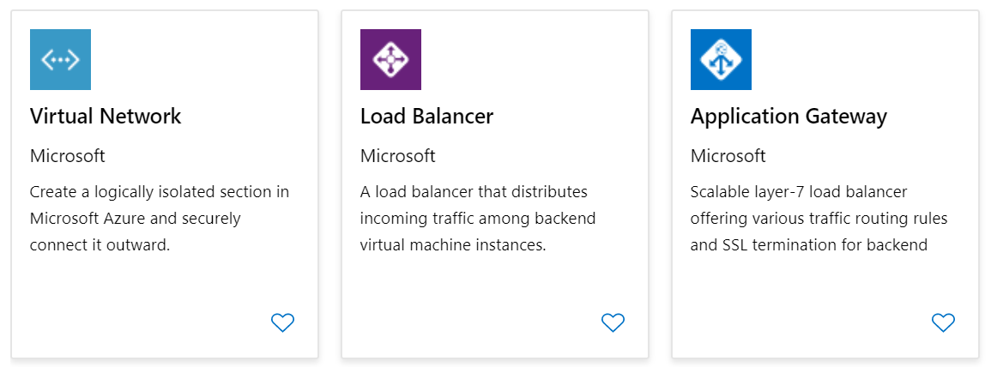
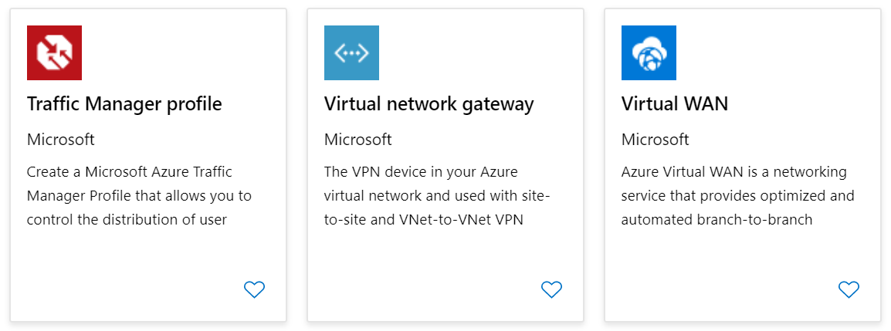
Azure Networking Components (optional)
Adopting cloud solutions can save time and simplify operations
Azure requires the same types of networking functionality as on-premises infrastructure
Azure networking offers a wide range of services and products
Notes:
Extra slide if you like.
Azure networking documentation - https://docs.microsoft.com/azure/networking/

Slide 40
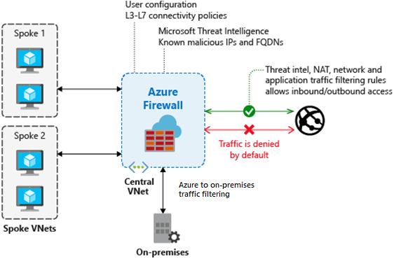
Determine Azure Firewall Uses
Stateful firewall as a service
Built-in high availability with unrestricted cloud scalability
Create, enforce, and log application and network connectivity policies
Threat intelligence-based filtering
Fully integrated with Azure Monitor for logging and analytics
Support for hybrid connectivity through deployment behind VPN and ExpressRoute Gateways
Notes:
Azure Firewall documentation - https://docs.microsoft.com/azure/firewall/

Slide 41
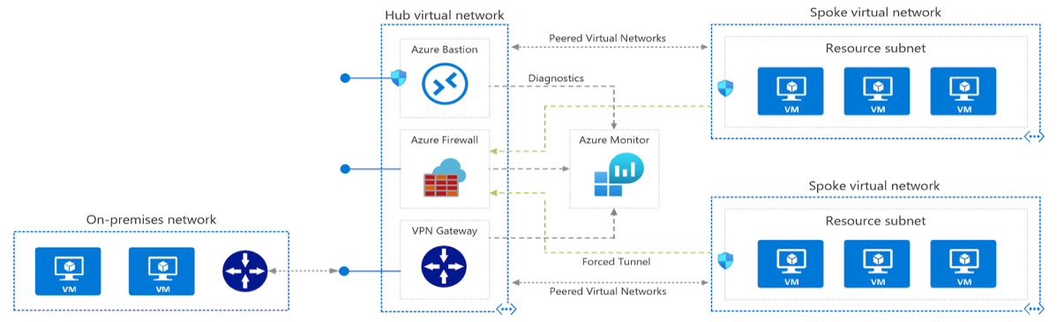
Create Azure Firewalls
A Hub-Spoke network topology is recommended
Shared services are placed in the hub virtual network
Each environment is deployed to a spoke to maintain isolation
Notes:
Hub-spoke network topology in Azure - https://docs.microsoft.com/azure/architecture/reference-architectures/hybrid-networking/hub-spoke

Slide 42
Create Azure Firewall Rules
Azure Firewall Manager centralizes firewall management
Firewall policies container rules and settings to control access
NAT rules allow incoming connections
Network rules contain source and destination addresses, protocols, and destination ports
Application rules provide qualified domain names (FQDNs) that can be accessed from a subnet
Notes:
Tutorial: Deploy and configure Azure Firewall and policy using the Azure portal - https://docs.microsoft.com/azure/firewall/tutorial-firewall-deploy-portal-policy

